Slide 1
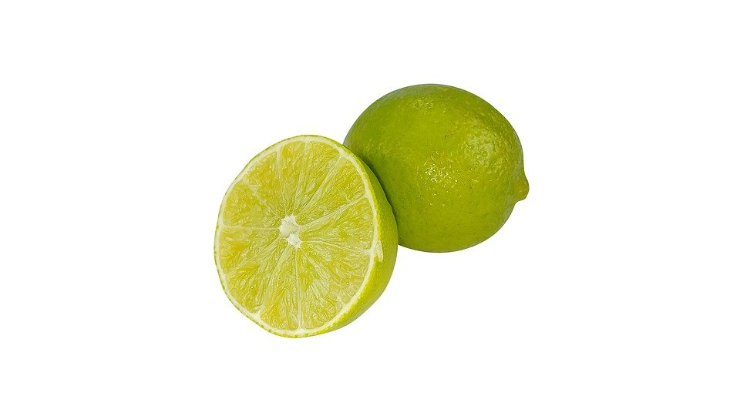
Spatial Arrangement in
Video Conferencing
Team Limetten

Slide 2
Insights
Simple UI
Arrangement of participants is up to the user
Screen Sharing & Filesharing
Permission/Role System

Slide 3
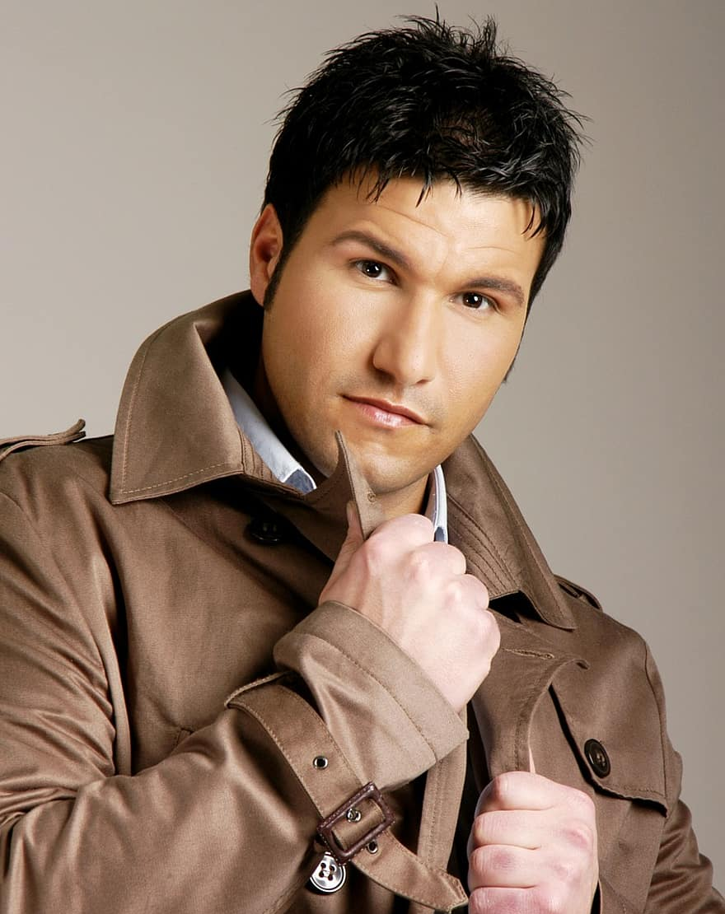
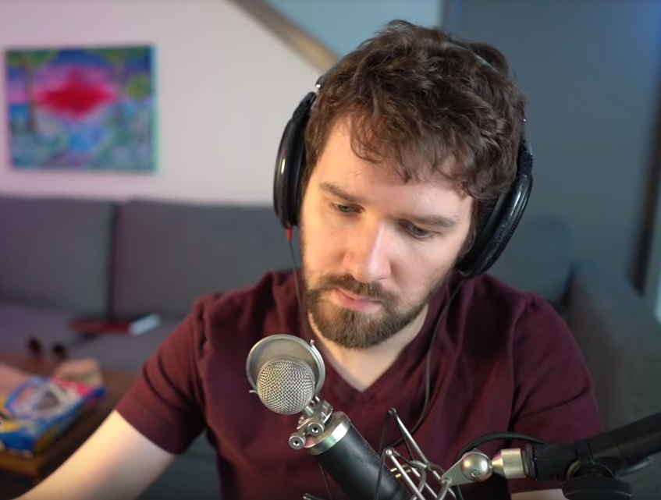
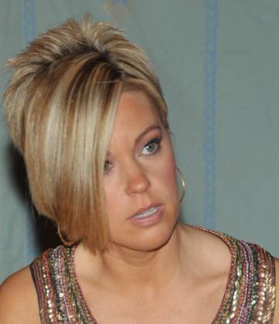
Personas
Silvano Da Silva
Raphael Yamamoto
Karen Smith
Notes:
Average User, Power User, Dummy User. Based on affinity diagram.
(Average User
Frequently uses Teams for work
The many features/buttons of Teams overwhelm him/her
Hopes Teams doesn’t crash when he/she makes a call
Power User
Has no trouble using any tool
Picks the tool that does exactly what he/she wants it to do
Likes to have full control
Inexperienced User
Uses the same tool as his/her friends
Had his/her friends and family set it up
Doesn’t know a feature exists if you explicitly show it to him/her
If it doesn’t work ⇒ restart)

Slide 4
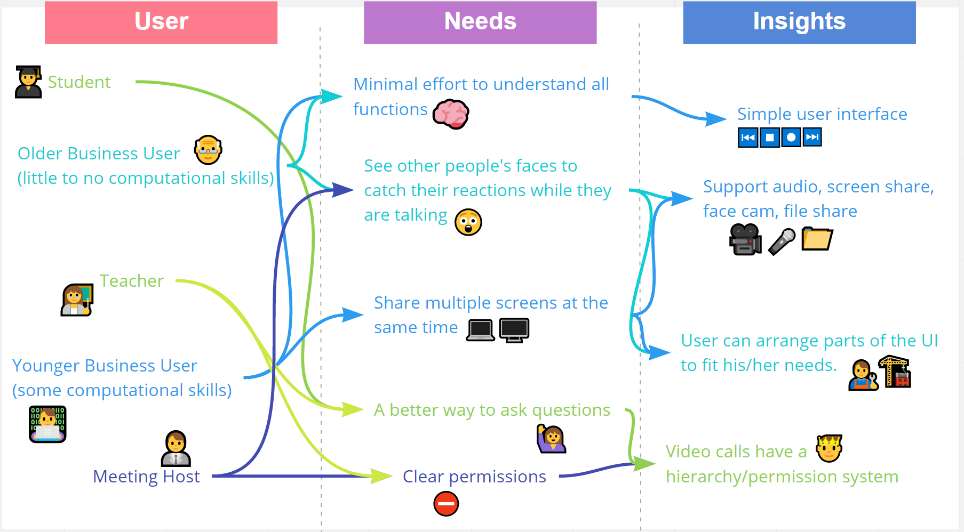
Affinity Diagram
Notes:
Here you can see our affinity diagram
Most of our interviewees either use it for school or for business
The students prefer a simple user interface with a better way to ask questions and clear permissions
On the other hand, business users really want to see the reactions of others and be able to share multiple screens, meaning more functionality
Based the insights we gathered, we came up with many more but also the 3 ideas you are about ot hear of

Slide 5
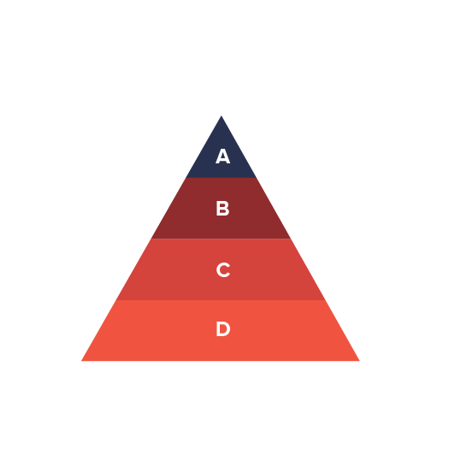
Level-based Permissions
give different participants in the call different levels
different levels, give different permissions
mute/unmute people with lower levels
rearrange the visual order
share files, share screen
access to different breakout rooms
lower level participants go through higher level participants to ask questions / get permissions

Slide 6
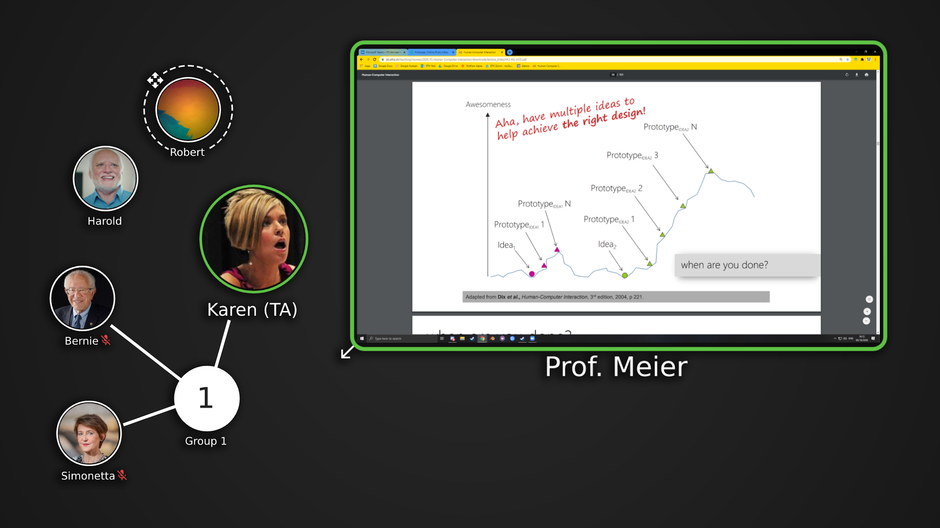
User-specific Conference Arrangement
Notes:
Participants appear as bubbles on a canvas (the shape doesn’t really matter).
Users can move/scale those bubbles to make their own arrangement.
Based on the “rank” of a user, it’s bubble initially appears larger.
The state of any participant (muted, speaking, … ) changes the corresponding bubble’s appearance.
The facecam, screen share is displayed in the bubble.
This might cause it to change its shape.
Groups could potentially be displayed as clusters connected by a “group bubble”.

Slide 7
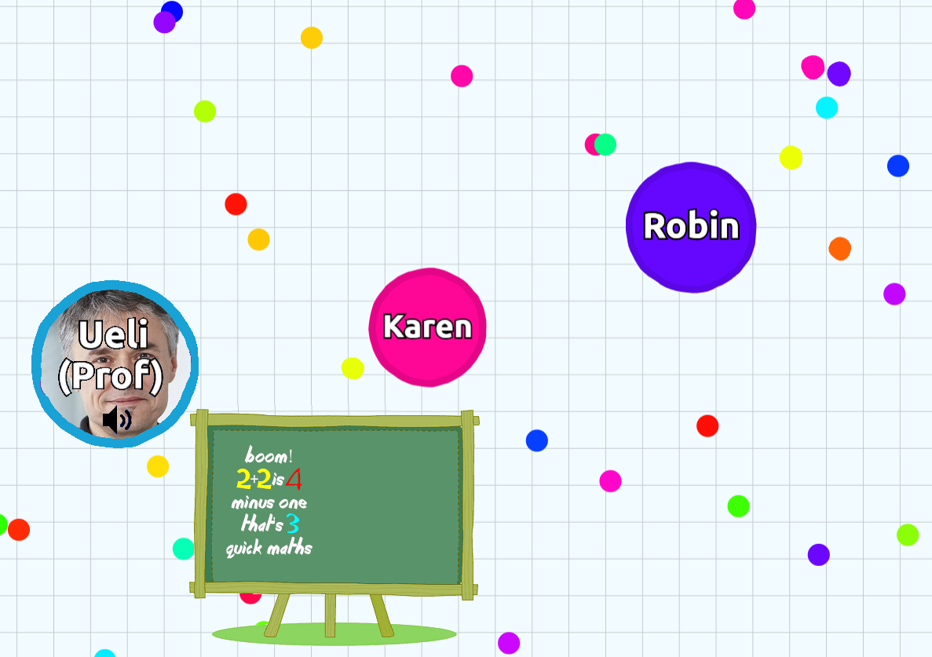
Agar.io Styled Arrangement
Notes:
Last but not least, we also wanted to present one of the many ideas we had based on fun and games
Participants appear as bubbles on the screen and can “walk” around, using the arrow keys
The voice of people that are closer appears louder
It often happens that one gets bored when a video call becomes too long
This idea might help in staying focused and prevent people from doing something else
It also helps detecting inactive users

